Slide 1
TỔNG QUAN VỀ
LẬP TRÌNH WEB
HUY INIT
Posts and Telecommunications Institute of Technology (PTIT)
Department of Computer Science

Slide 2




Academic Background
Member, Faculty of Information Technology,
PTIT
Mar. 2024 – Present
M.Sc. in Computer Science, PTIT
May 2026
M.Sc. in Information Science, JAIST Sep. 2026
Research Interests
Computer Vision
Explainable Artificial Intelligence (XAI)
Recommender Systems
Continual Learning
Educational Technology (EdTech)
Nguyen Quang Huy, M.Sc.

Slide 3
Contact Information
Github: https://github.com/huyinit
Facebook: https://www.facebook.com/huyinit13
Instagram: https://www.instagram.com/huyinit/
Youtube Bài Giảng: https://www.youtube.com/@huyinit
Youtube Vlog: https://www.youtube.com/@huyinitvlog
Seeking Research Collaboration
I welcome collaboration with researchers, graduate and undergraduate students, and industry professionals working in AI, RS, XAI, Continual Learning, and related fields. Whether you are interested in joint publications, undergraduate or graduate thesis projects, research internships, research discussions, or interdisciplinary collaborations, I would be happy to connect and explore new ideas together. Feel free to contact me at huynq@ptit.edu.vn.

Slide 4
1. Cách tính điểm
2. Tài liệu và nền tảng học tập
CC : 10% - Đi học đủ 9 điểm
Bài tập : 20% -
Thực hành : 20% -
Điểm thi :
Điểm cộng:
Nếu giơ tay giải bài tập => 1 điểm cộng .
Nếu giơ tay thuyết trình => 1 điểm cộng .
Chia sẻ và tương tác tốt trên lớp => 0,5-1 điểm cộng.
Điểm trừ :
Nghỉ học 1 buổi => -2 điểm trừ
Đi muộn => -1 điểm trừ

Slide 5
Môn học: Phát triển Ứng dụng Web
Giới thiệu các công nghệ và nền tảng để xây dựng ứng dụng web hiện đại.
Tìm hiểu kiến trúc Full Stack: Trình duyệt (Browser) ⇔ Máy chủ Web (Web Server) ⇔ Cơ sở dữ liệu (Database/Storage System).
Mục tiêu học tập: Hiểu quy trình xây dựng, triển khai và vận hành một ứng dụng web hoàn chỉnh.
Học thông qua thực hành (Learning by Doing) bằng cách phát triển các dự án thực tế.
Làm quen với các công nghệ phổ biến:
Frontend: React.js
Backend: Node.js + Express.js, Django (Python)
Database: MongoDB (và giới thiệu tích hợp với các hệ quản trị CSDL khác)
Kết quả đạt được: Có khả năng thiết kế, xây dựng và triển khai một ứng dụng web Full Stack, đồng thời hiểu cách các thành phần Frontend, Backend và Database phối hợp với nhau trong một hệ thống thực tế.

Slide 6
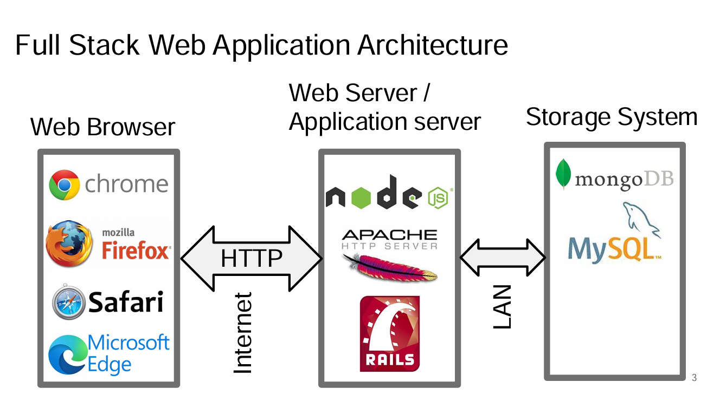

Slide 7
1. Frontend Development
2. Backend Development
3. Communication & APIs
4. Database Systems
5. DevOps & Cloud Computing
6. Web Security
7. Emerging Trends
& AI-Powered Web Development
Front-end web development, also known as client-side development is the practice of producing some markup languages and other tools for a website or Web Application so that a user can see and interact with them directly.
Back-end development—also known as server-side development—is the architecture, code, and databases that power a website or web application behind the scenes. It focuses on the parts of the application that users don’t see or interact with directly.
An API, or application programming interface, is a set of rules or protocols that enables software applications to communicate with each other to exchange data, features and functionality.
A database is an organized collection of structured information, or data, typically stored electronically in a computer system. A database is usually controlled by a database management system (DBMS).
DevOps is a modern software development approach that combines development (Dev) and operations (Ops) to streamline collaboration, accelerate delivery, and improve software quality.
Cloud computing is the on-demand delivery of IT resources over the Internet with pay-as-you-go pricing. Instead of buying, owning, and maintaining physical data centers and servers, you can access technology services, such as computing power, storage, and databases, on an as-needed basis from a cloud provider.
Web Application Security, often abbreviated as Web AppSec, is a set of practices, technologies, and processes designed to safeguard web applications from various threats, vulnerabilities, and attacks.

Slide 8
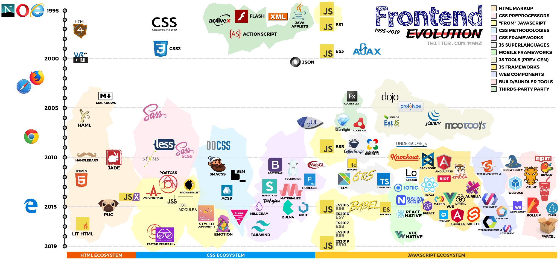
frontend-evolution/frontend-evolution.png at master · ManzDev/frontend-evolution

Slide 9
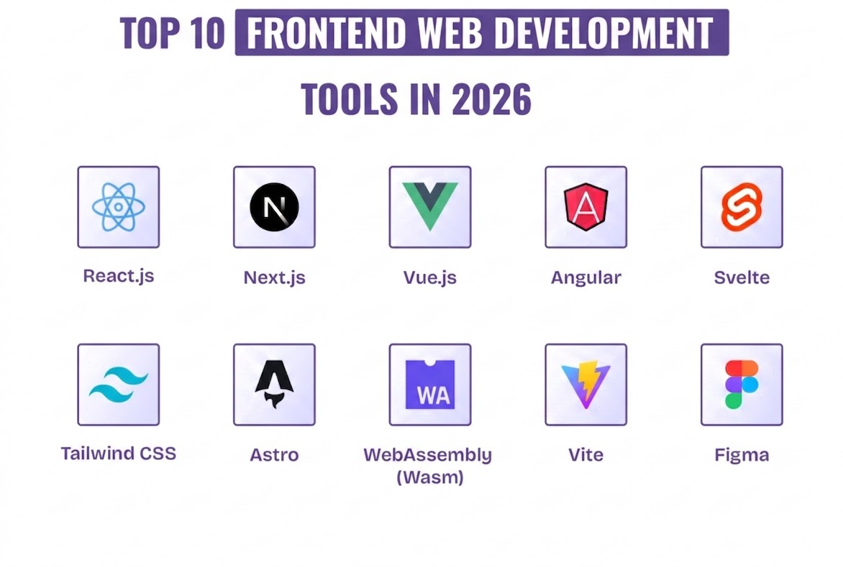
1. Frontend Development
2. Backend Development
3. Communication & APIs
4. Database Systems
5. DevOps & Cloud Computing
6. Web Security
7. Emerging Trends
& AI-Powered Web Development
Front-end web development, also known as client-side development is the practice of producing some markup languages and other tools for a website or Web Application so that a user can see and interact with them directly.
Best Web Development Tools in 2026

Slide 10
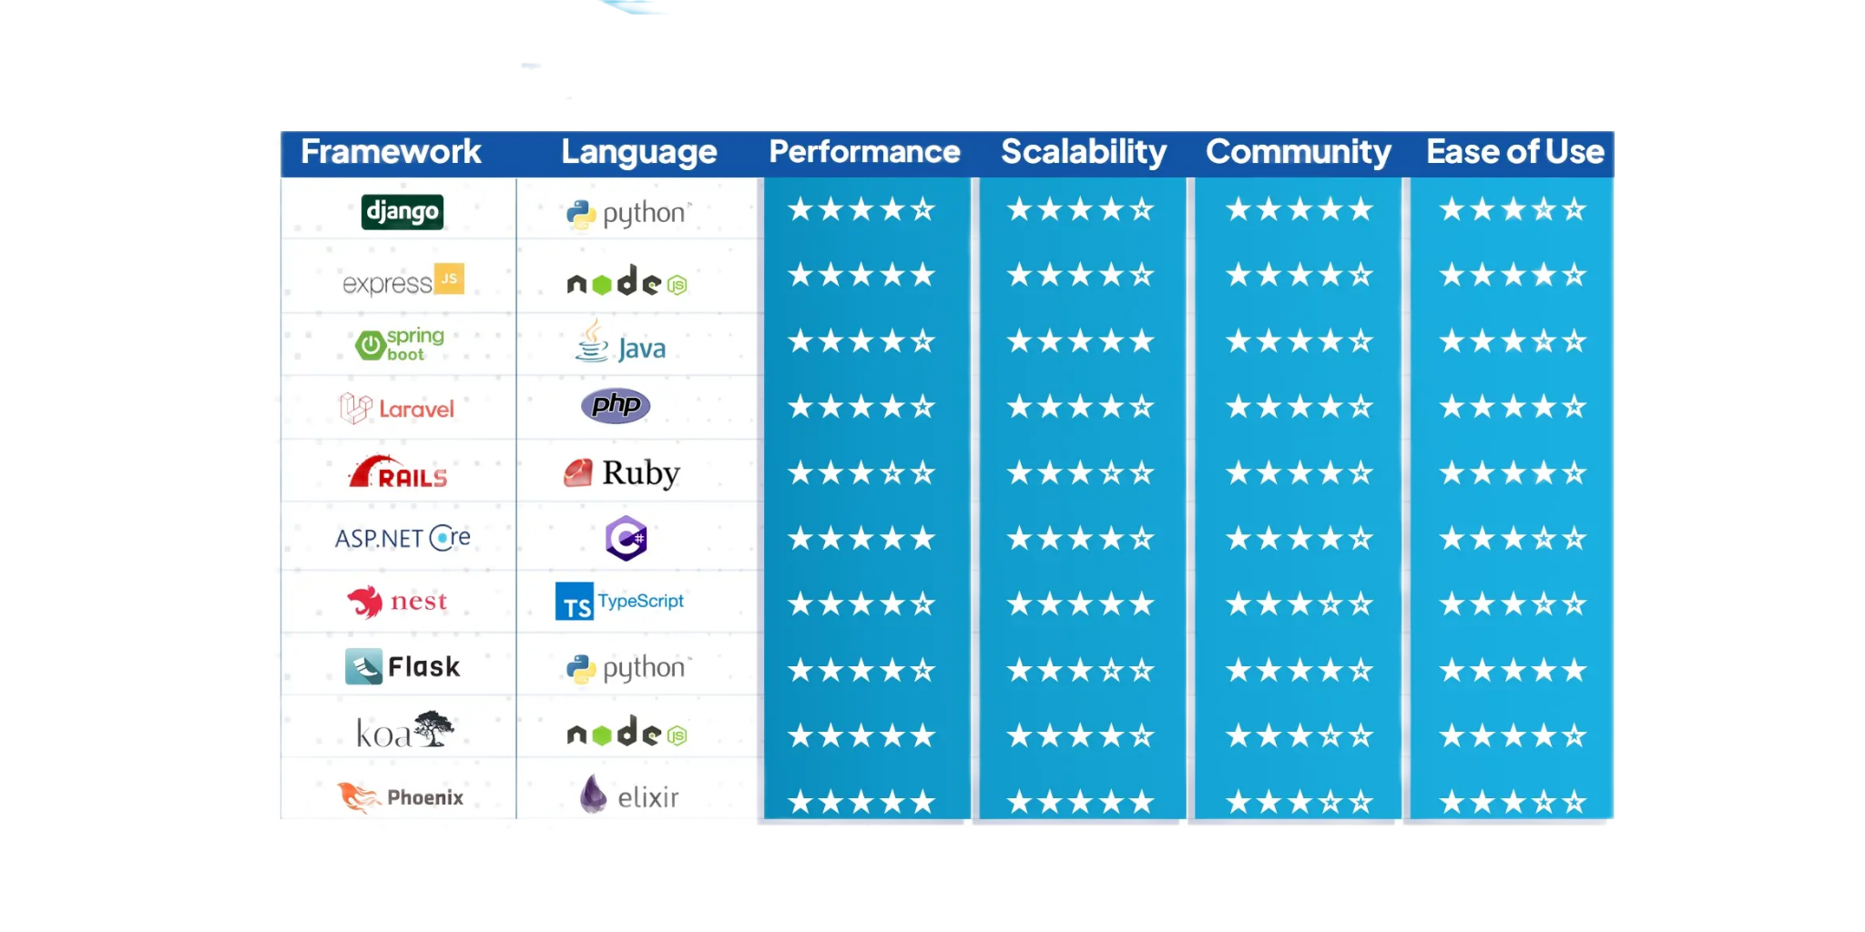
1. Frontend Development
2. Backend Development
3. Communication & APIs
4. Database Systems
5. DevOps & Cloud Computing
6. Web Security
7. Emerging Trends
& AI-Powered Web Development
Back-end development—also known as server-side development—is the architecture, code, and databases that power a website or web application behind the scenes. It focuses on the parts of the application that users don’t see or interact with directly.
Top Ten Backend Frameworks in 2025: Maximize Efficiency

Slide 11
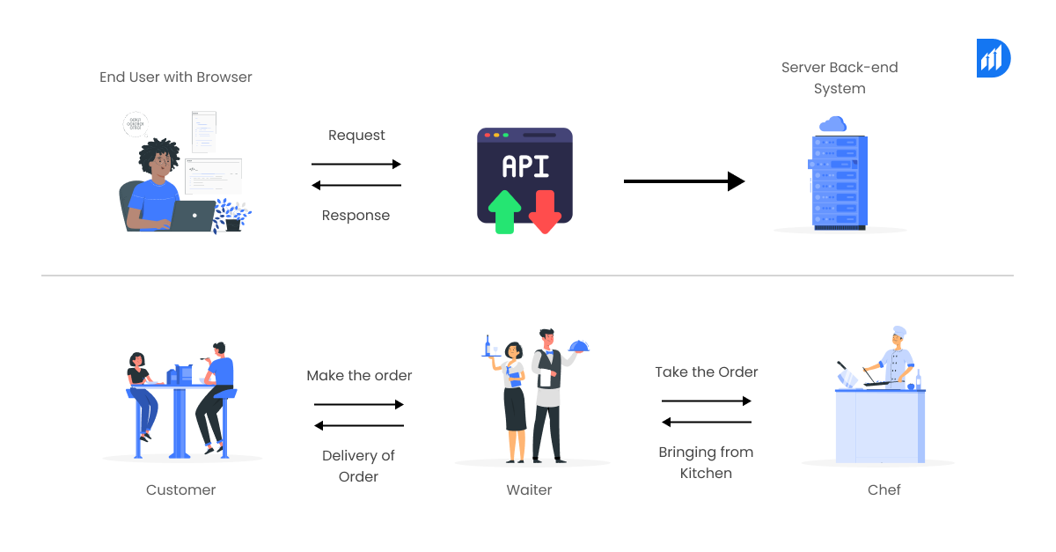
1. Frontend Development
2. Backend Development
3. Communication & APIs
4. Database Systems
5. DevOps & Cloud Computing
6. Web Security
7. Emerging Trends
& AI-Powered Web Development
An API, or application programming interface, is a set of rules or protocols that enables software applications to communicate with each other to exchange data, features and functionality.
How Do APIs Help the Frontend and Backend Communicate in Cloud Applications?

Slide 12
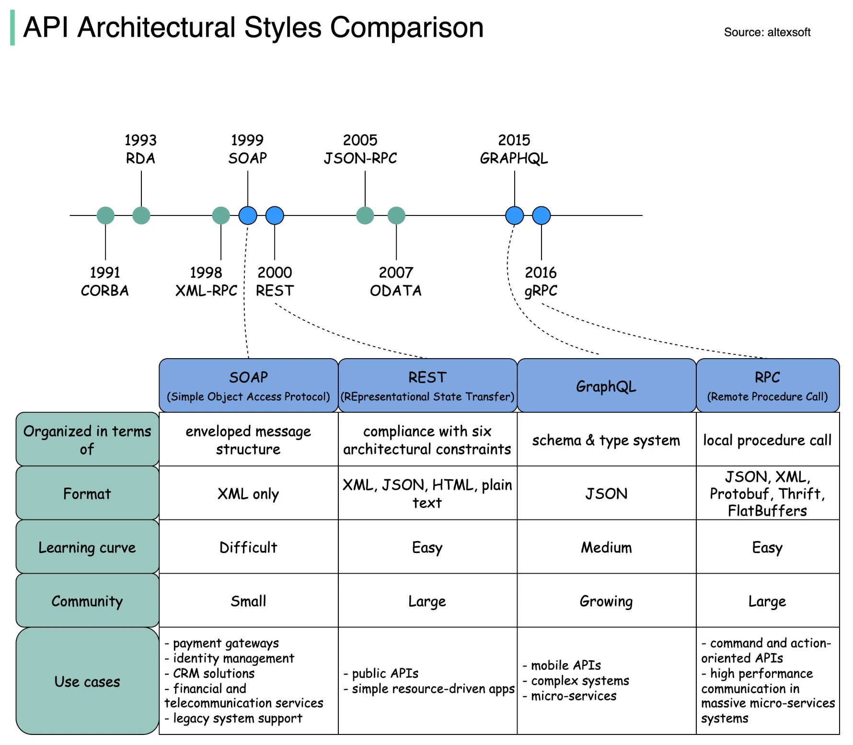
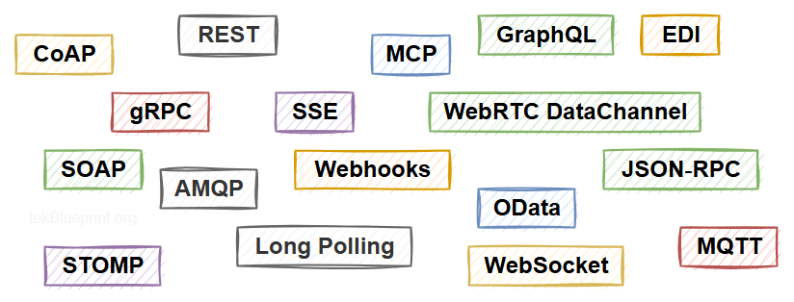
[Technology] What happened when I looked into APIs｜単純な知的労働業務をなくす専門家 │ Apient
1. Frontend Development
2. Backend Development
3. Communication & APIs
4. Database Systems
5. DevOps & Cloud Computing
6. Web Security
7. Emerging Trends
& AI-Powered Web Development
Types and architectural styles API | tekBlueprint

Slide 13
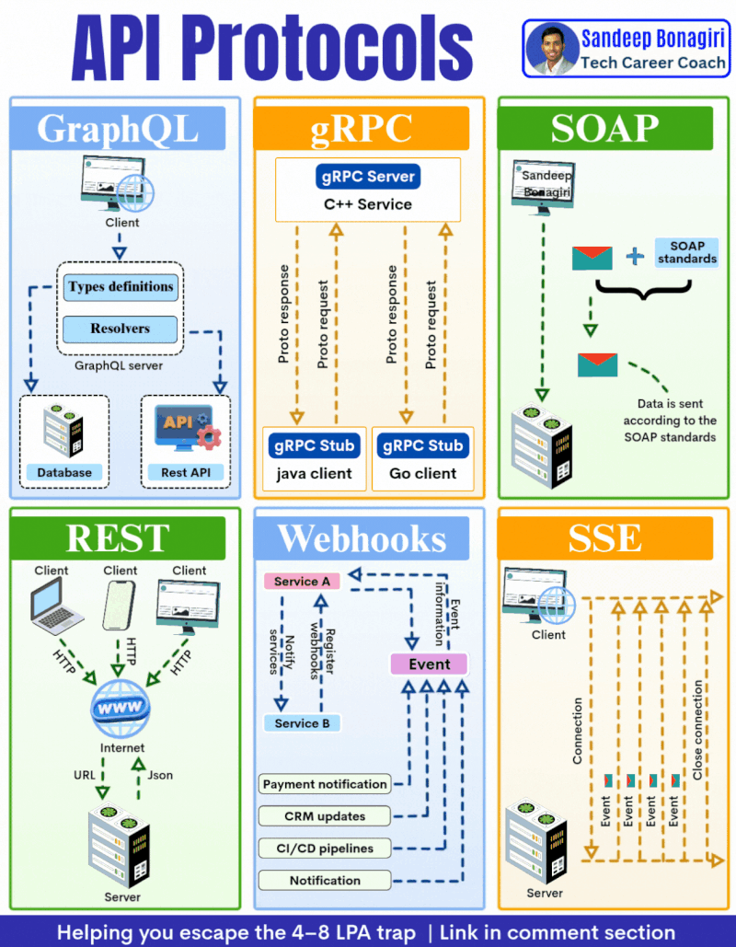
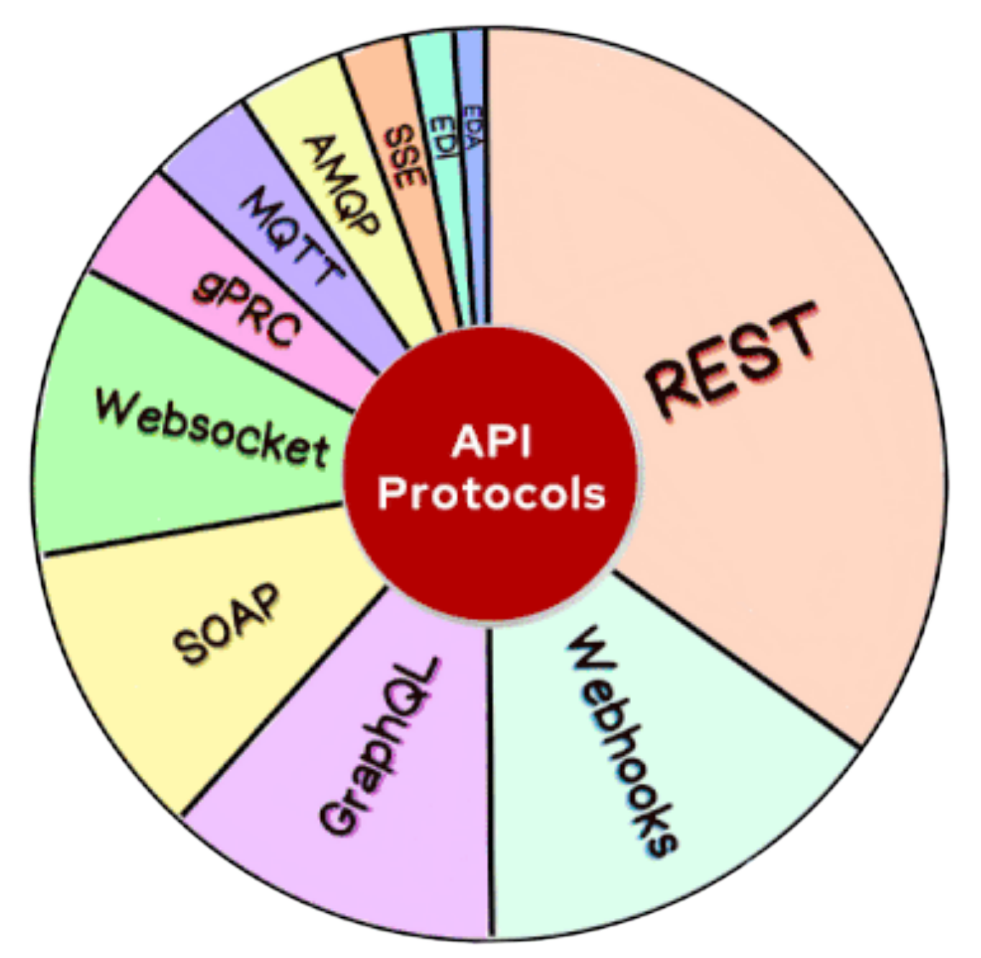
1. Frontend Development
2. Backend Development
3. Communication & APIs
4. Database Systems
5. DevOps & Cloud Computing
6. Web Security
7. Emerging Trends
& AI-Powered Web Development
How APIs work and their types: A guide by Oliver | freeCodeCamp posted on the topic | LinkedIn

Slide 14
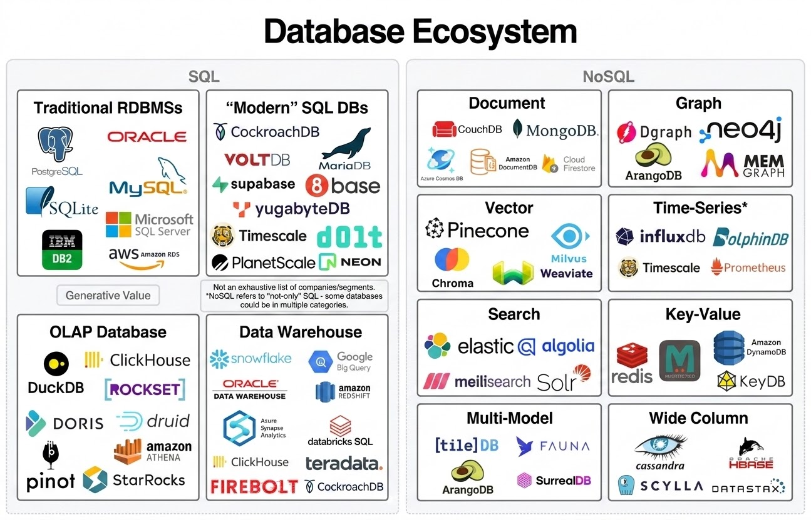
1. Frontend Development
2. Backend Development
3. Communication & APIs
4. Database Systems
5. DevOps & Cloud Computing
6. Web Security
7. Emerging Trends
& AI-Powered Web Development
A database is an organized collection of structured information, or data, typically stored electronically in a computer system. A database is usually controlled by a database management system (DBMS).
A Primer on Databases - Generative Value

Slide 15
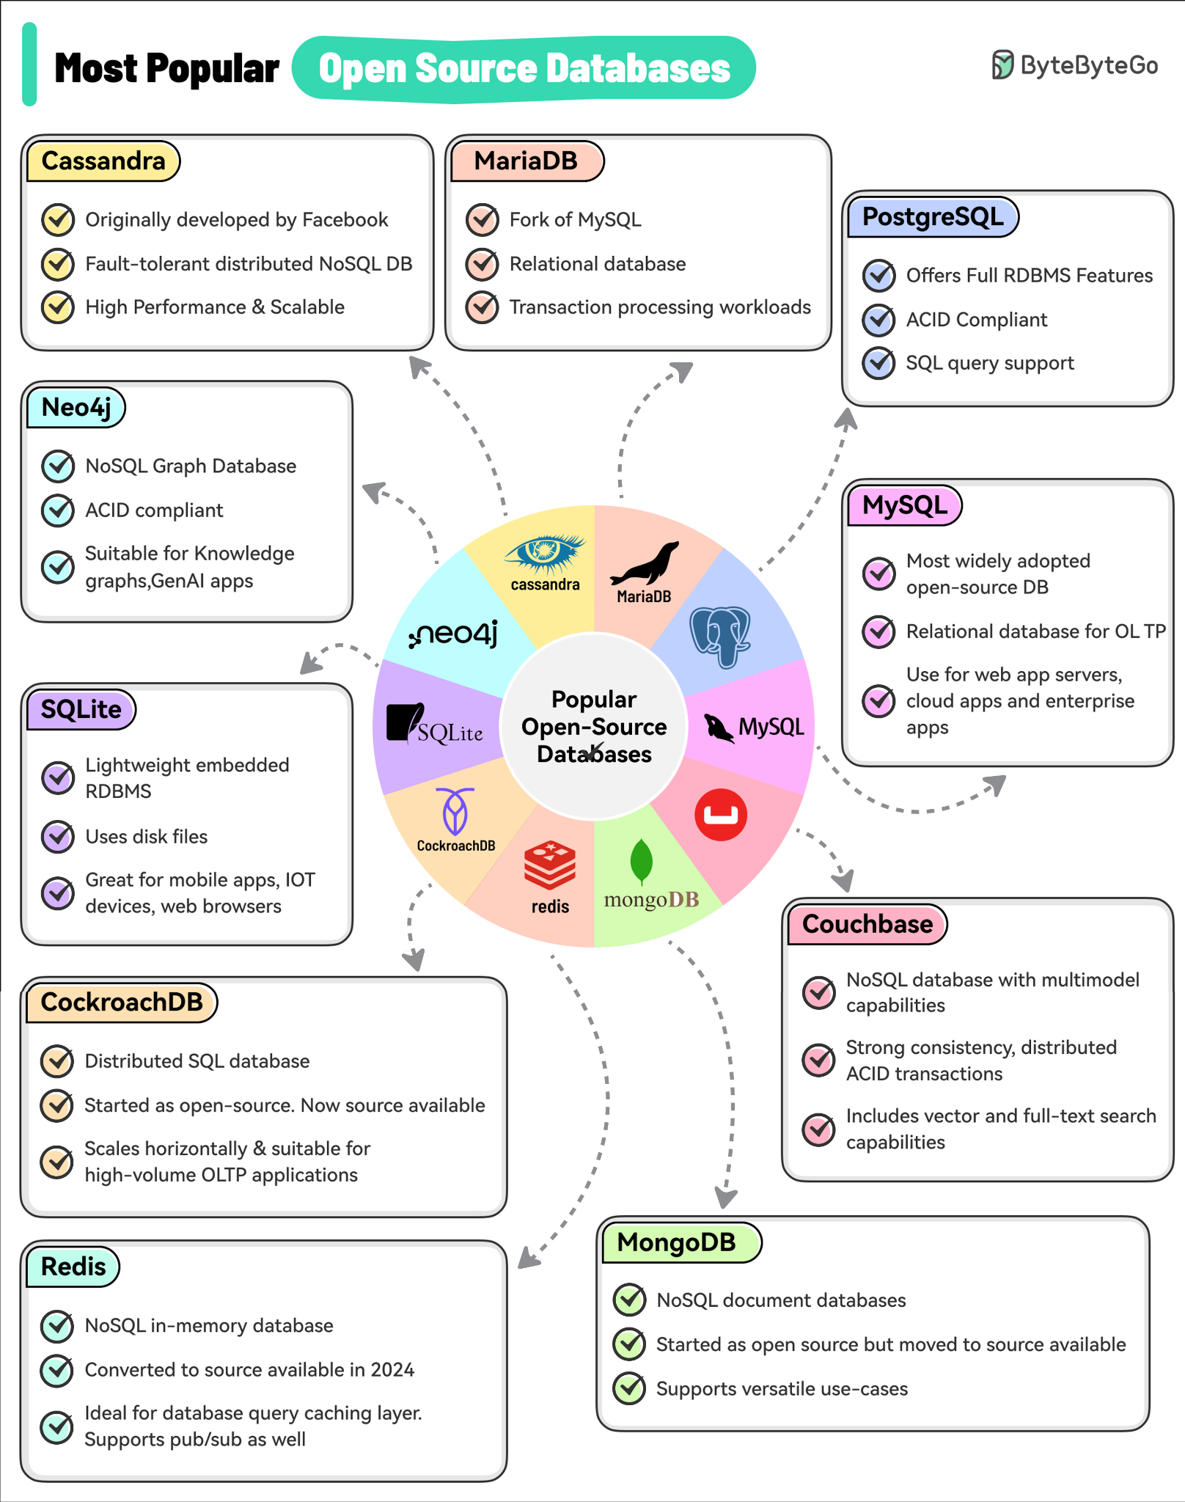
1. Frontend Development
2. Backend Development
3. Communication & APIs
4. Database Systems
5. DevOps & Cloud Computing
6. Web Security
7. Emerging Trends
& AI-Powered Web Development
A database is an organized collection of structured information, or data, typically stored electronically in a computer system. A database is usually controlled by a database management system (DBMS).
ByteByteGo | Top 10 Most Popular Open-Source Databases

Slide 16
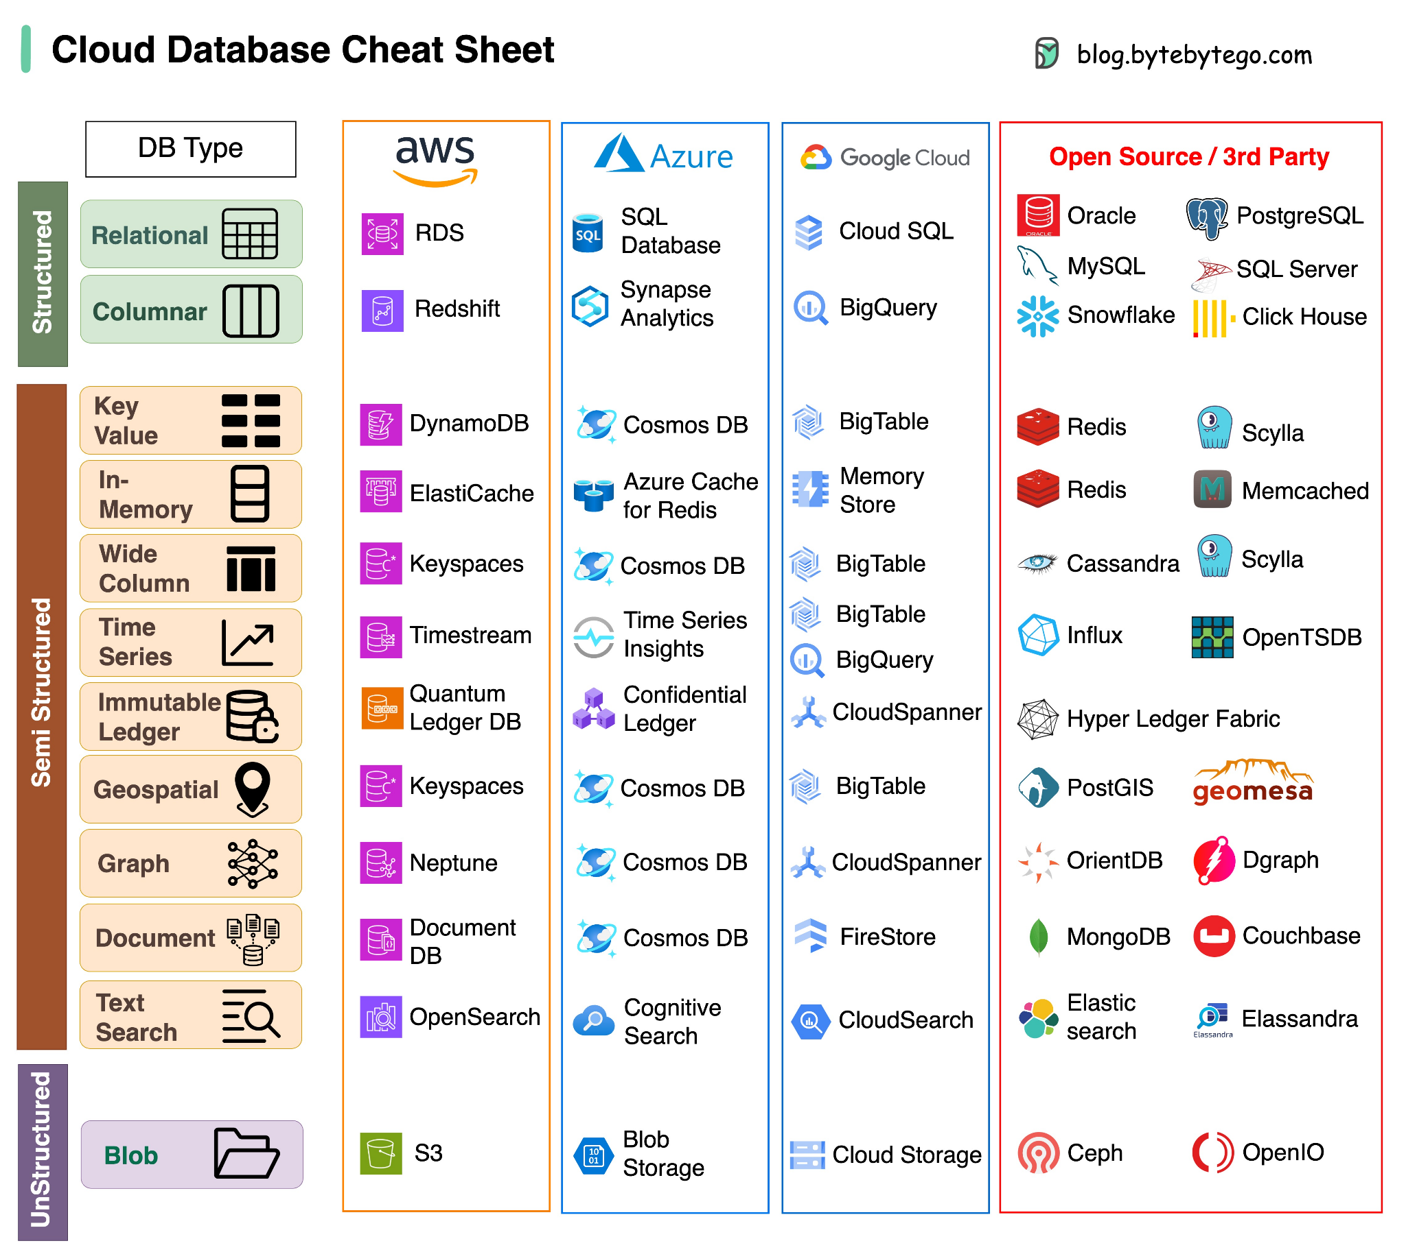
1. Frontend Development
2. Backend Development
3. Communication & APIs
4. Database Systems
5. DevOps & Cloud Computing
6. Web Security
7. Emerging Trends
& AI-Powered Web Development
"A cloud database is a database that typically runs on a cloud computing platform, and access to the database is provided as a service."
ByteByteGo | Cloud Database Cheat Sheet
Notes:
📖 Giải thích slide (đúng ý, không lan man)
📌 Providing Actionable Insights
Use big data & learning analytics → XAI không chỉ giải thích cho có, mà phải tận dụng dữ liệu lớn để tạo ra thông tin hữu ích thật sự.
Support real decisions in education → Ví dụ: gợi ý tài liệu học, phát hiện sinh viên có nguy cơ rớt, điều chỉnh nội dung môn học.
Detect bias & improve fairness → Hệ thống phải giúp phát hiện thiên vị thuật toán và đảm bảo công bằng.
Guide cognitive & metacognitive learning → Không chỉ nói “em làm sai”, mà hướng dẫn cách suy nghĩ, cách học hiệu quả hơn.
📌 Personalized Feedback
Explanations tailored to individuals → Không phải ai cũng cần cùng một kiểu giải thích.
Consider ability, traits, emotions → Cần tính đến năng lực, tính cách, trạng thái cảm xúc của từng sinh viên.
When, how, and how much to explain → Phải cân nhắc: giải thích lúc nào, bằng cách nào, và bao nhiêu là đủ.
Personalization improves motivation → Khi giải thích phù hợp cá nhân, sinh viên có động lực học hơn và thay đổi hành vi tích cực hơn.

Slide 17
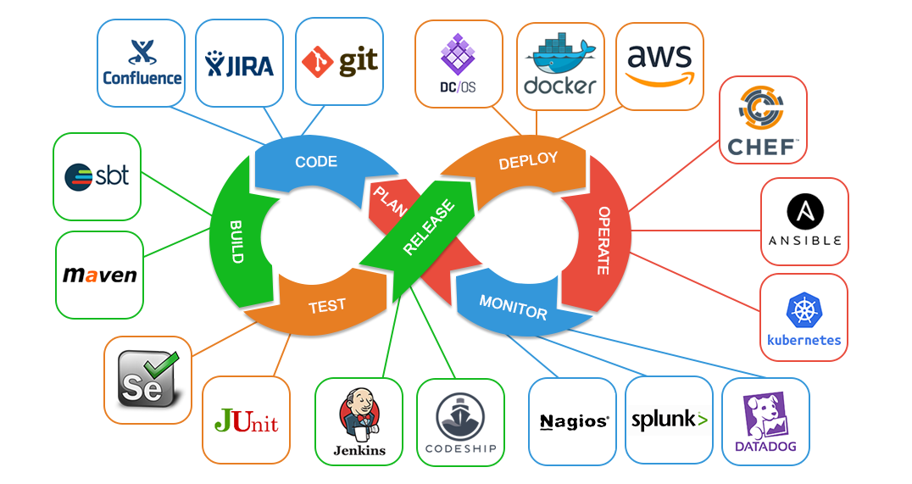
1. Frontend Development
2. Backend Development
3. Communication & APIs
4. Database Systems
5. DevOps & Cloud Computing
6. Web Security
7. Emerging Trends
& AI-Powered Web Development
DevOps is a modern software development approach that combines development (Dev) and operations (Ops) to streamline collaboration, accelerate delivery, and improve software quality.
Overview of DevOps

Slide 18
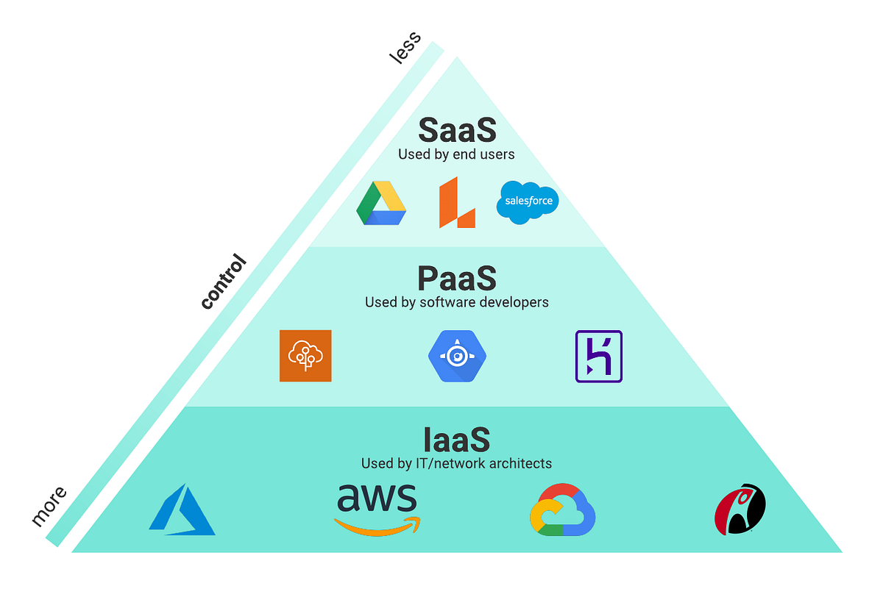
1. Frontend Development
2. Backend Development
3. Communication & APIs
4. Database Systems
5. DevOps & Cloud Computing
6. Web Security
7. Emerging Trends
& AI-Powered Web Development
Cloud computing is the on-demand delivery of IT resources over the Internet with pay-as-you-go pricing. Instead of buying, owning, and maintaining physical data centers and servers, you can access technology services, such as computing power, storage, and databases, on an as-needed basis from a cloud provider.

Slide 19
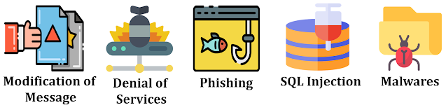
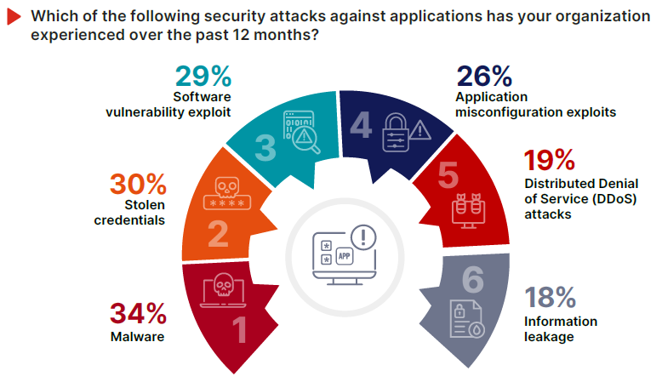
1. Frontend Development
2. Backend Development
3. Communication & APIs
4. Database Systems
5. DevOps & Cloud Computing
6. Web Security
7. Emerging Trends
& AI-Powered Web Development
Web Application Security, often abbreviated as Web AppSec, is a set of practices, technologies, and processes designed to safeguard web applications from various threats, vulnerabilities, and attacks.
Chirag's Blog: What is Web Security? | Purpose of Web security | Web Security Threats and Approaches | How can achieve web security | web security threats

Slide 20
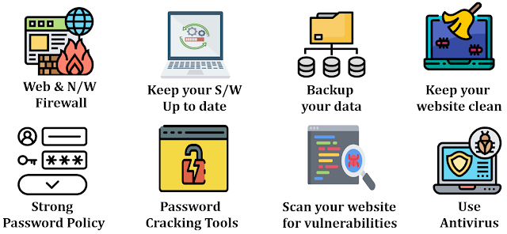
1. Frontend Development
2. Backend Development
3. Communication & APIs
4. Database Systems
5. DevOps & Cloud Computing
6. Web Security
7. Emerging Trends
& AI-Powered Web Development
Chirag's Blog: What is Web Security? | Purpose of Web security | Web Security Threats and Approaches | How can achieve web security | web security threats

Slide 21
1. Frontend Development
2. Backend Development
3. Communication & APIs
4. Database Systems
5. DevOps & Cloud Computing
6. Web Security
7. Emerging Trends
& AI-Powered Web Development
7. Emerging Trends
AI-Powered Web Development (OpenAI API, RAG, MCP, LangChain, LangGraph, AI Agents, Prompt Engineering)
Modern Web Architectures (AI-Native Applications, Edge Computing, Serverless Computing, Local-First Applications, WebAssembly)
Next-Generation User Experiences (Agentic UX, Generative UI, Full-Stack Type Safety)
AI-Assisted Software Engineering (GitHub Copilot, Cursor, Claude Code, Vibe Coding, AI-Driven Testing, AI-Driven Code Review)
(5) Facebook

Slide 22
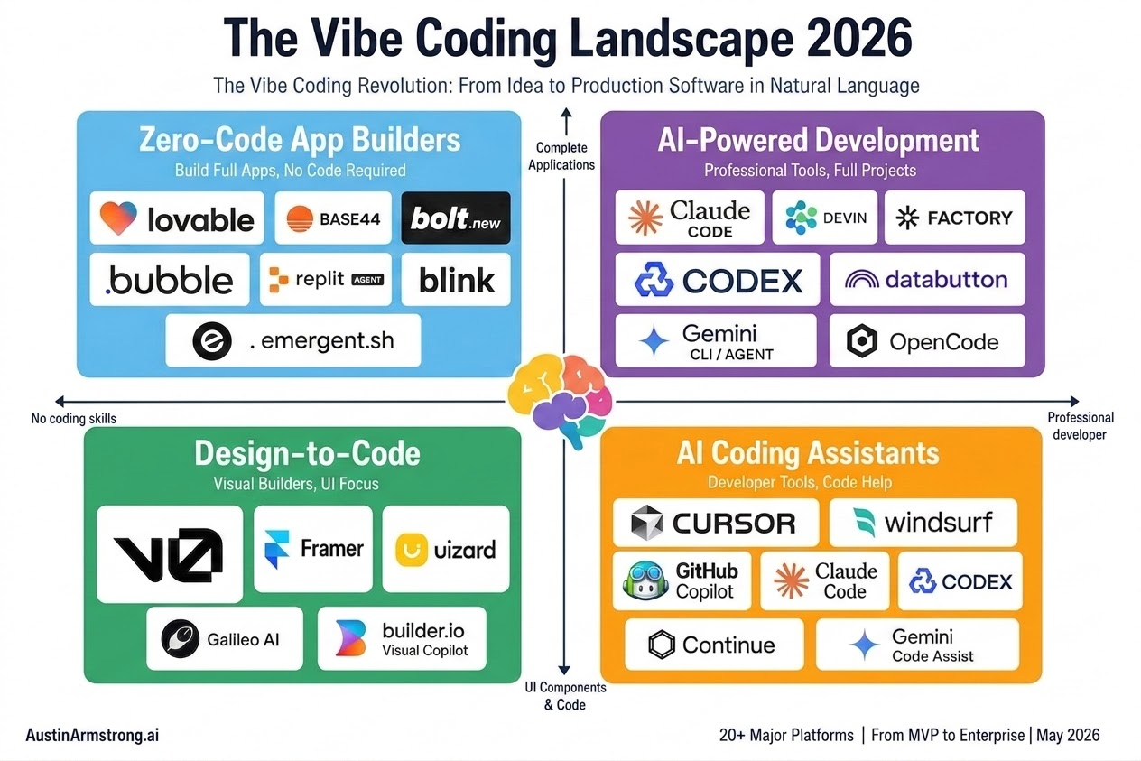
1. Frontend Development
2. Backend Development
3. Communication & APIs
4. Database Systems
5. DevOps & Cloud Computing
6. Web Security
7. Emerging Trends
& AI-Powered Web Development
"An emerging programming paradigm where developers primarily write code by interacting with code-generating large language models rather than writing code directly."
(5) Facebook

Slide 23

THANK
YOU
FOR LEARNING

Slide 24



QNA

Slide 25
next
HTML , CSS
Notes:
Phần 2: Giải thích đời thường (tiếng Việt)
📊 Kết quả DT: giải thích luôn giống nhau (stability cao) và mô phỏng đúng hành vi mô hình (fidelity cao)
⚠️ Lưu ý: Fidelity chỉ nói giải thích khớp với mô hình, không đảm bảo mô hình đoán đúng
Ví dụ: mô hình và mô phỏng cùng dự đoán sai → fidelity vẫn = 100%
💡 Ý nghĩa: Chúng ta phải xem cả độ chính xác dự đoán, không chỉ fidelity & stability

